Slide 1

Statistical Physics of Resource Competition in a Highly Diverse Ecosystem
Clelia Corridori
1230664
March 8, 2021
Notes:
Organisms shape their own environment, which in turn affects their survival. This feedback becomes especially important for communities containing a large number of species; however, few existing approaches allow studying this regime, except in simulations. Here, we use methods of statistical physics to analytically solve a classic ecological model of resource competition introduced by MacArthur in 1969

Slide 2
Resource Competition Model
Introduction
Theory of the model
Simulations and new observations
Conclusions
“Collective Phase in Resource Competition in a Highly Diverse Ecosystem”, Tikhonov and Monasson

Slide 3
introduction

Slide 4
The focus
Organisms
Environment
Notes:
Ecological (dell’environment) and evolutionary time scales not separables

Slide 5
The focus
Organisms
Environment
Ecoevolutionary dynamics for a large number of interacting species

Slide 6
The focus
Organisms
Environment
Ecoevolutionary dynamics for a large number of interacting species
It is possible to set the external condition faced by the community
The immediate environment for each individual depends from all other organisms

Slide 7

History
1969 Mac Arthur proposed an ecogical model of resource competition in a well-mixed community at equilibrium
1983 Tilman gives a geometrical description of the model for a low number of resources ($N=1,2$)
2016 Tikhonov proposed a simulation-based study for a modestly large number of resources exhibiting community cohesion as a consequence of environmental feedback
Notes:
The mechanisms by which organisms shape their environment have been the subject of much research, both at equilibrium and out of equilibrium
Mac Arthur
Tilman
?? How to generalize?
Tikhonov ha iniziato con simulazioni
an intriguing possibility is that the phenomenology of high-diversity communities could contain qualitatively novel, nonintuitive regimes. → studiamo well mixed population at equilibrium with deterministic dynamis

Slide 8


The aim
Tikhonov and Monasson proposed the analytical solution of the classic model of resource competition in the limit of large $N$
We wanto to model the feedback of organisms onto environment
Notes:
We show that the nonintuitive phenomenology of highly diverse ecosystems includes a phase where the environment constructed by the community becomes fully decoupled from the outside world. In this phase emerges a collective behavior as consequence of large dimensionality

Slide 9
Theory of the model
The basis

Slide 10

Basic quantities
Multispecies community in a well-mixed habitat
Single limiting element $Χ$ in $N$ forms $i∈\{1, …, N\}$ substrates
Total supply of resource $R_{i}$, $∀i$
Notes:
Purely competitive

Slide 11

Basic quantities
Multispecies community in a well-mixed habitat
Single limiting element $Χ$ in $N$ forms $i∈\{1, …, N\}$ substrates
Total supply of resource $R_{i}$, $∀i$
$P=αN$ species $μ∈\{1, …, P\}$ with $n_{μ}$ population size and $Χ_{μ}$ requirement for the limiting element
$\vec{σ_{μ}}={\left\{σ_{μi}\right\}}_{i=1,…,N} ∀μ$, metabolic strategies: species are defined by the their pathways

Slide 12

Basic quantities
Multispecies community in a well-mixed habitat
Single limiting element $Χ$ in $N$ forms $i∈\{1, …, N\}$ substrates
Total supply of resource $R_{i}$, $∀i$
$P=αN$ species $μ∈\{1, …, P\}$ with $n_{μ}$ population size and $Χ_{μ}$ requirement for the limiting element
$\vec{σ_{μ}}={\left\{σ_{μi}\right\}}_{i=1,…,N} ∀μ$, metabolic strategies: species are defined by the their pathways
Total demand of the i-th resource form, $∀i:$ $T_{i}=\sum_{μ}{n_{μ}σ_{μi}}$

Slide 13

Basic quantities
Multispecies community in a well-mixed habitat
Single limiting element $Χ$ in $N$ forms $i∈\{1, …, N\}$ substrates
Total supply of resource $R_{i}$, $∀i$
$P=αN$ species $μ∈\{1, …, P\}$ with $n_{μ}$ population size and $Χ_{μ}$ requirement for the limiting element
$\vec{σ_{μ}}={\left\{σ_{μi}\right\}}_{i=1,…,N} ∀μ$, metabolic strategies: species are defined by the their pathways
Total demand of the i-th resource form, $∀i:$ $T_{i}=\sum_{μ}{n_{μ}σ_{μi}}$
$h_{i}$ resource avaiability, $∀i,$ in the immediate environment

Slide 14


Basic quantities
Multispecies community in a well-mixed habitat
Single limiting element $Χ$ in $N$ forms $i∈\{1, …, N\}$ substrates
Total supply of resource $R_{i}$, $∀i$
$P=αN$ species $μ∈\{1, …, P\}$ with $n_{μ}$ population size and $Χ_{μ}$ requirement for the limiting element
$\vec{σ_{μ}}={\left\{σ_{μi}\right\}}_{i=1,…,N} ∀μ$, metabolic strategies: species are defined by the their pathways
Total demand of the i-th resource form, $∀i:$ $T_{i}=\sum_{μ}{n_{μ}σ_{μi}}$
$h_{i}$ resource avaiability, $∀i,$ in the immediate environment
Resource surplus $Δ_{μ}=\sum_{i}{σ_{μi} h_{i}−Χ_{μ}}$ determines the population growth

Slide 15

What we want
For a specific $\{h_{i}\}$ the population growth rate of the species $μ$ is determined by $Δ_{μ}$
$$\frac{dn_{μ}}{dt}\sim n_{μ}Δ_{μ}$$

Slide 16




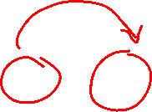
What we want
For a specific $\{h_{i}\}$ the population growth rate of the species $μ$ is determined by $Δ_{μ}$
$$\frac{dn_{μ}}{dt}\sim n_{μ}Δ_{μ}=0$$
We are interested in the feedback loop at equilibrium:
$${\{T}_{i}\}$$
$$\{h_{i}\}$$
$${\{n}_{μ}\}$$
Notes:
The dynamics possesses a Lyapunov function, which is convex and bounded from above, similar to the classic model of MacArthur—of which this is a generalization; see the Supplemental Material (SM) [22]. As a result, the equilibrium state always exists, is unique and stable, and can be found by solving a convex optimization problem over the region ∂Ω.

Slide 17





From outside to inside
$$h_{i}=H_{i}\left(T_{i}\right)$$
Resource depletion rule in general is an arbitrary decreasing function, different for each resource
Simple model: Organisms could share the fixed total influx of resource
$$h_{i}=\frac{R_{i}}{T_{i}}$$
Mac Arthur model: dinamical resources with renewal rate $r_{i}$ and maximal availability $K_{i}$
$$h_{i}=K_{i}(1−\frac{T_{i}}{r_{i}})$$
Notes:
The resource depletion rules Hi describe the external conditions: how much of each resource is supplied to the community as a whole. In contrast, h~ describes the availability of resources in the immediate environment of individuals, which ultimately dictates which species survive

Slide 18
Theory of the model
The geometrical description

Slide 19









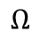
The geometrical description
Consider:
$\vec{σ_{μ}}$ $P$ vectors in the $N$-dimensional space of resouces availability
$\vec{h}⋅{\vec{σ}}_{μ}=Χ_{μ}$ hyperplane, $∀μ$
$$Ω=\bigcap_{μ=1}^{P}{\left\{\vec{h} | \vec{h}⋅\vec{σ_{μ}}<Χ_{μ}\right\}}$$
We can define the Unsustainable Region:
$$h_{1}$$
$$\left\{\begin{aligned}\vec{h} inside Ω → \frac{dn_{μ}}{dt}<0, ∀μ \\ \vec{h} outside Ω → \frac{dn_{μ}}{dt}>0, at least for one μ \\ \vec{h} on the surface ∂Ω → \frac{dn_{μ}}{dt}=0\end{aligned}\right.$$
$$σ_{1}$$
$$Ω$$
$$σ_{12}$$
$$σ_{2}$$
$$h_{2}$$

Slide 20


The geometrical description
Consider:
$\vec{σ_{μ}}$ $P$ vectors in the $N$-dimensional space of resouces availability
$\vec{h}⋅{\vec{σ}}_{μ}=Χ_{μ}$ hyperplane, $∀μ$
$$Ω=\bigcap_{μ=1}^{P}{\left\{\vec{h} | \vec{h}⋅\vec{σ_{μ}}<Χ_{μ}\right\}}$$
We can define the Unsustainable Region:
$$h_{1}$$
$$\left\{\begin{aligned}\vec{h} inside Ω → \frac{dn_{μ}}{dt}<0, ∀μ \\ \vec{h} outside Ω → \frac{dn_{μ}}{dt}>0, at least for one μ \\ \vec{h} on the surface ∂Ω → \frac{dn_{μ}}{dt}=0\end{aligned}\right.$$
$$σ_{1}$$
$$Ω$$
$$σ_{12}$$
$$σ_{2}$$
$$h_{2}$$

Slide 21





The geometrical description
Consider:
$\vec{σ_{μ}}$ $P$ vectors in the $N$-dimensional space
$\vec{h}⋅{\vec{σ}}_{μ}=Χ_{μ}$ hyperplane, $∀μ$
$$Ω=\bigcap_{μ=1}^{P}{\left\{\vec{h} | \vec{h}⋅\vec{σ_{μ}}<Χ_{μ}\right\}}$$
We can define the Unsustainable Region:
$$h_{1}$$
At equilibrium: $\left\{\begin{aligned}n_{μ}=0, Δ_{μ}<0,extinct \\ n_{μ}>0, Δ_{μ}=0,survivals\end{aligned}\right.$
$$σ_{1}$$
$$Ω$$
$$σ_{12}$$
$$σ_{2}$$
$$h_{2}$$

Slide 22

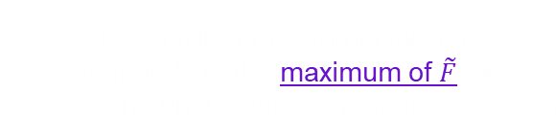
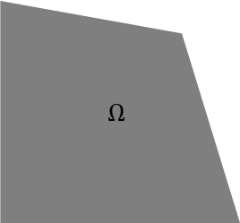




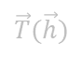

The geometrical description
?
How to find the equilibrium point ${\vec{h}}^{∗}∈∂Ω$?
$∃\tilde{F}$, defined in the harvest space, such that:
$$\frac{∂\tilde{F}}{∂h_{i}}=T_{i} ⇔ H_{i}\left(T_{i}\right)=h_{i}, ∀i$$
$$h_{1}$$
$${\vec{T}}^{∗}=n_{1}\vec{σ_{1}}+n_{2}\vec{σ_{2}}$$
The equilibrium community state corresponds to the maximum of $\tilde{F}$ over the unsustainable region $Ω$
$$Ω$$
Aim: study the properties of a community at equilibrium, given by
the mapping the external resources $\vec{R}$ into the environment at equilibrium ${\vec{h}}^{∗}$ → for a typical community
$$σ_{1}$$
$$\vec{T}(\vec{h})$$
$$σ_{2}$$
$$h_{2}$$
Notes:
Passing into the Harvest space: we have shown that locating the equilibrium of our ecological dynamics is in fact a convex optimization problem in the P-dimensional space of species abundances. We then described how this optimization problem can be formulated directly in the N-dimensional space of “harvests” hi . To build intuition, it is instructive to consider the following algebraic argument showing how the two optimization problems are mapped into each other.

Slide 23




The geometrical description
We consider:
$$H_{i}(T_{i})=\frac{R_{i}}{T_{i}}$$
The general function is:
$\tilde{F}\left(\{h_{i}\}\right)=[\vec{h}⋅\vec{T}−\sum_{i}{{\hat{H}}_{i}(T_{i})}]$ with ${\hat{H}}_{i}\left(T_{i}\right)=\int{H_{i}\left(T_{i}\right)dT_{i}}$
In our case we get:
${\hat{H}}_{i}\left(T_{i}\right)=R_{i}\log{T_{i}}$ and $T_{i}^{∗}=\frac{R_{i}}{h_{i}^{∗}}$
The function that we need to maximize is:
$$\tilde{F}\left(\{h_{i}\}\right)=\sum_{i}{R_{i}logh_{i}+const}$$

Slide 24
Theory of the model
For a large number of interacting species
Notes:
In higher dimensions, however, the enumeration of coexistence regimes for a given set of strategies, as in Fig. 1(b), quickly becomes a combinatorially difficult problem. In this Letter, we therefore adopt the statistical physics approach and characterize the expected properties of a typical community where the competing strategies are drawn out of some ensemble.

Slide 25


The Statistical Physics approach
We need to model the pool of competitors $P=αN$, f$\text{or} α=cost \text{and} N→∞$
$∀μ$ we get:
$\vec{σ_{μ}}$ random binary vector with $σ_{μi}=\left\{\begin{aligned}1 with probability p \\ 0 with probability 1−p\end{aligned}\right.$
Random cost $Χ_{μ}=\sum_{i}{σ_{μi}}+εx_{μ}$, where${ x}_{μ}\sim N(0,1)$

Slide 26

The Statistical Physics approach
We need to model the pool of competitors $P=αN$, f$\text{or} α=cost \text{and} N→∞$
$∀μ$ we get:
$\vec{σ_{μ}}$ random binary vector with $σ_{μi}=\left\{\begin{aligned}1 with probability p \\ 0 with probability 1−p\end{aligned}\right.$
Random cost $Χ_{μ}=\sum_{i}{σ_{μi}}+εx_{μ}$, where${ x}_{μ}\sim N(0,1)$
THE ASSUMPTION: The costs $Χ_{μ}$ and the metabolic strategies ${\{σ}_{μi}\}$ are uncorrelated, $→$ we can describe the competing strategies set with three parameters:
$p$ sparsity
$ε$ width of the cost distribution
$α$ that determines the effective number of species in the pool
Notes:
cost model

Slide 27


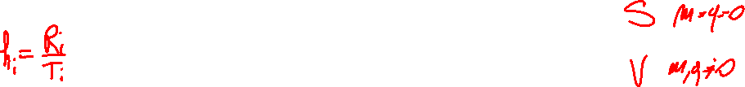
The Statistical Physics approach
We need to model the pool of competitors $P=αN$, f$\text{or} α=cost \text{and} N→∞$
$∀μ$ we get:
$\vec{σ_{μ}}$ random binary vector with $σ_{μi}=\left\{\begin{aligned}1 with probability p \\ 0 with probability 1−p\end{aligned}\right.$
Random cost $Χ_{μ}=\sum_{i}{σ_{μi}}+εx_{μ}$, where${ x}_{μ}\sim N(0,1)$
Setting $h_{i}=1$ the resource balance of all species is satisfied: neither specialists nor generalists are favourited
We can characterize the fluctuations of the resource availability:
$$m=\sum_{i}{\left(1−h_{i}\right)}$$
$$q=\sum_{i}{{\left(1−h_{i}\right)}^{2}}$$

Slide 28


The Statistical Physics approach
We need to model the pool of competitors $P=αN$, f$\text{or} α=cost \text{and} N→∞$
$∀μ$ we get:
$\vec{σ_{μ}}$ random binary vector with $σ_{μi}=\left\{\begin{aligned}1 with probability p \\ 0 with probability 1−p\end{aligned}\right.$
Random cost $Χ_{μ}=\sum_{i}{σ_{μi}}+εx_{μ}$, where${ x}_{μ}\sim N(0,1)$
Our partition function in the harvest space is
$$Z=\int_{0}^{∞}{\prod_{i}{dh_{i} e^{β\tilde{F}} }\prod_{μ}^{P}{θ\left(Χ_{μ}−\vec{h}⋅{\vec{σ}}_{μ}\right)}}$$

Slide 29
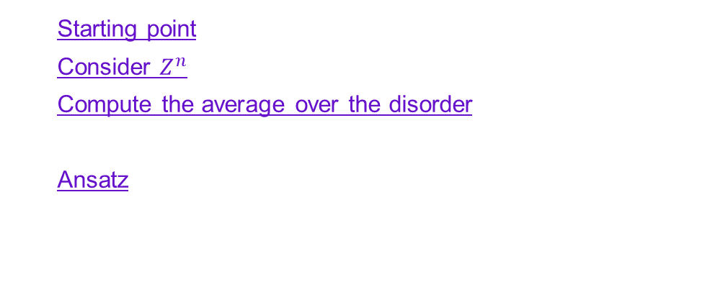

typical realization
We are interested in the behavior of the typical realization of the system, thus we want to compute:
Replica trick
$$\left\langle logZ\right\rangle =\lim_{n→0}{\frac{\left\langle Z^{n}\right\rangle −1}{n}}$$
Starting point
Consider $Z^{n}$
Compute the average over the disorder
Decouple indices of resource availability $i$ and species $μ$
Ansatz
Compute the limit $n→0$
Final expression

Slide 30


The solution
$$\left\langle logZ\right\rangle =β extr\left\{\frac{\overline{γ}−x}{2x\overline{γ}}q+ \frac{\overline{δτ^{2}}}{2}x − \frac{λτψ\left(q\right)}{p} − \frac{αψ^{2}\left(q\right)}{2xp\left(1−p\right)}I(λ)\right\}$$
with $I\left(λ\right)= \int_{λ}^{∞}{{\left(y−λ\right)}^{2}e^{−\frac{y^{2}}{2}}}\frac{dy}{\sqrt{2π}}$
The extremum is over $x, q$ and $λ$
$\overline{τ},\overline{δτ^{2}}, \overline{γ}$ characterize the resource supply In our case $\overline{τ}=\overline{R}=1,\overline{γ}=1,$ and $\overline{δτ^{2}}=\overline{δR^{2}}$
$p$, $α$ and $ε$ characterize the pool of competitors
Notes:
$p$ sparsity, $α$ and $ε$ characterize the pool of competitors

Slide 31









The solution
$$\left\langle logZ\right\rangle =β extr\left\{\frac{\overline{γ}−x}{2x\overline{γ}}q+ \frac{\overline{δτ^{2}}}{2}x − \frac{λτψ\left(q\right)}{p} − \frac{αψ^{2}\left(q\right)}{2xp\left(1−p\right)}I(λ)\right\}$$
$$=A$$
Using the extremum condition we get:
$$\frac{∂A}{∂x}=0$$
$$\overline{δτ^{2}}−\frac{q}{\overline{x^{2}}}+ \frac{αψ^{2}}{x^{2}p\left(1−p\right)}I\left(λ\right)=0$$
$$\frac{∂A}{∂q}=0$$
$$\frac{1−αI(λ)}{x}=\frac{1}{γ}+\frac{\frac{λ}{ψ}\left(1−p\right)}{ψ}τ$$
$$\frac{∂A}{∂λ}=0$$
$$−2−\frac{αψ}{x \overline{τ}\left(1−p\right)}\frac{dI}{dλ}=0$$

Slide 32


The solution
$$\left\langle logZ\right\rangle =β extr\left\{\frac{\overline{γ}−x}{2x\overline{γ}}q+ \frac{\overline{δτ^{2}}}{2}x − \frac{λτψ\left(q\right)}{p} − \frac{αψ^{2}\left(q\right)}{2xp\left(1−p\right)}I(λ)\right\}$$
$$=A$$
Using the extremum condition we get:
$$\frac{∂A}{∂x}=0$$
$\frac{x}{\overline{γ}}=1−αE(λ)$ with $E\left(λ\right)=\int_{λ}^{∞}{e^{−\frac{y^{2}}{2}}}\frac{dy}{\sqrt{2π}}$
$$\frac{∂A}{∂q}=0$$
$$\frac{1−αI(λ)}{1−αE(λ)}=1+\frac{λ}{ψ}(1−p)$$
$$\frac{∂A}{∂λ}=0$$
$$ψ^{2}[1−αI\left(λ\right)]=ε^{2}+{\left(1−αE\left(λ\right)\right)}^{2}{\overline{γ}}^{2}p(1−p)\overline{δτ^{2}}$$

Slide 33


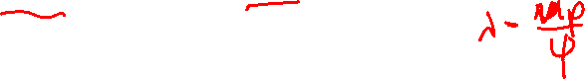
The solution
$$\left\langle logZ\right\rangle =β extr\left\{\frac{\overline{γ}−x}{2x\overline{γ}}q+ \frac{\overline{δτ^{2}}}{2}x − \frac{λτψ\left(q\right)}{p} − \frac{αψ^{2}\left(q\right)}{2xp\left(1−p\right)}I(λ)\right\}$$
$$=A$$
Studing the system for $H_{i}=\frac{R_{i}}{T_{i}}$ with $\overline{R}=1$, $\overline{δτ^{2}}=\overline{δR^{2}}$, $\overline{γ}=1:$
$$\frac{1−αI(λ)}{1−αE(λ)}=1+(1−p)\frac{λ}{ψ}$$
$$ψ^{2}[1−αI\left(λ\right)]=ε^{2}+{p(1−p)\left(1−αE\left(λ\right)\right)}^{2}\overline{δR^{2}}$$

Slide 34

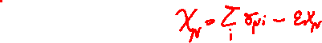

The order parameter
$$ψ\left(q\right)=\sqrt{p\left(1−p\right)q+ε^{2}}$$
It describes the spread of resource surplus
We are interested in the limit $ε→0,$in this case we get:
The scatter of intrinsic organisms cost is negligible
It is possible to focus on the interaction-dependent factors
Notes:
Qui la teoria + da cost model e replica trick in SM

Slide 35
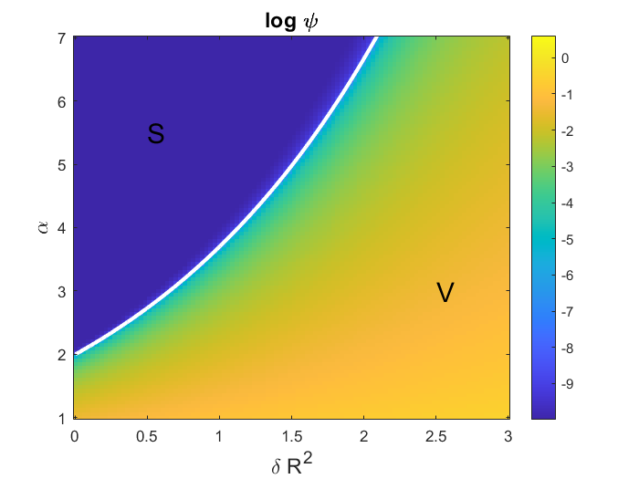

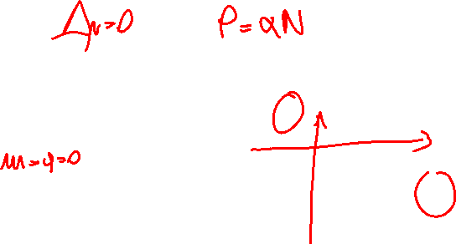









The Phase Transition
For $ε→0$:
We have the separation of the parameter space in two phases:
S phase: environment shielded from external
conditions, $ψ=0$
V phase: environment vulnerable to the external
conditions, $ψ≠0$
the critical line is $\overline{{δR}_{∗}^{2}}=\frac{1−p}{p}\frac{λ^{2}}{1−α_{∗}I(λ)}$
with $λ=E^{−1}(1/α_{crit})$

Slide 36
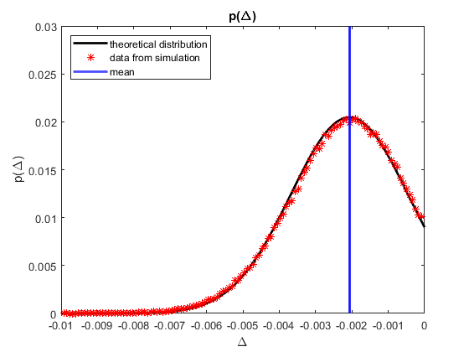
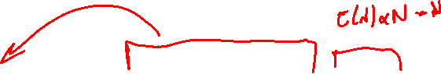


The number of species that survive
We can compute the distribution of the resource surplus of all the species $P=αN$ at equilibrium
$$p\left(Δ\right)=\frac{1}{\sqrt{2πψ^{2}}}e^{−\left[\frac{{\left(Δ+λψ\right)}^{2}}{2ψ^{2}}\right]}θ\left(−Δ\right)+E(λ)δ(Δ)$$
$\left\langle Δ_{μ}\right\rangle =\left\langle \sum_{i}{h_{i}σ_{μi}−Χ_{mu}}\right\rangle =−pm$, $m=\sum_{i}{\left(1−h_{i}\right)}$
The number of survivors is given by the fraction of species whose resource demand is met, $Δ_{μ}=0$

Slide 37
simulations

Slide 38

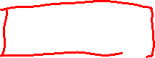


The Method
We generate the pool of competitors, $∀μ$ we get:
$\vec{σ_{μ}}={\left\{σ_{μi}\right\}}_{i=1,…,N}$ and ${ Χ}_{μ}=\sum_{i}{σ_{μi}}+εx_{μ}$, with $x_{μ}\sim N(0,1)$
Given the resource depletion rule $H_{i}(T_{i})=\frac{R_{i}}{T_{i}}$ and considering the resource supply $R_{i}= \overline{R}±\frac{δR_{i}}{\sqrt{N}}=1±\frac{1}{\sqrt{50}}$
we want to find the equilibrium point $\vec{h^{∗}}$ computing the maximum of:
$\tilde{F}\left(\{h_{i}\}\right)=\sum_{i}{R_{i}logh_{i}+const}$
The resource surplus distribution
The number of surviving species at equilibrium, given by $Δ_{μ}=0$
The equilibrium availability of resources
The phase transition for different values of $ε$
Notes:
Qui la teoria + da cost model e replica trick in SM

Slide 39
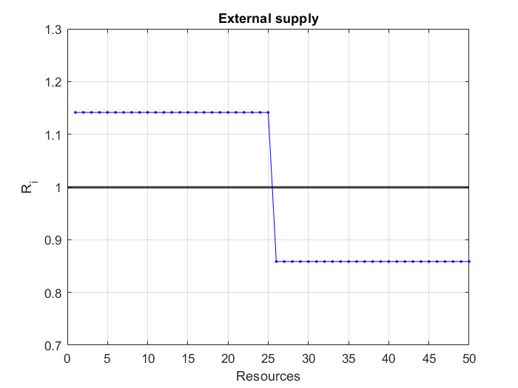


The External Supply
$$H_{i}(T_{i})=\frac{R_{i}}{T_{i}}$$
$$N=50$$
$$\overline{R}=1$$
$$\overline{δR^{2}}=1$$
$R_{i}= \overline{R}±\frac{δR_{i}}{\sqrt{N}}=1±\frac{1}{\sqrt{50}}$
Notes:
Qui la teoria + da cost model e replica trick in SM

Slide 40


The resource surplus distribution
$$\#realizations=500$$
$$N=50$$
$$p=0.5$$
$$\overline{δR^{2}}=1$$
$$\overline{R}=1$$
$$ε={10}^{−3}$$
$$α_{S}=10$$
$$p\left(Δ\right)=\frac{1}{\sqrt{2πψ^{2}}}e^{−\left[\frac{{\left(Δ+λψ\right)}^{2}}{2ψ^{2}}\right]}θ\left(−Δ\right)$$
Notes:
Qui la teoria + da cost model e replica trick in SM

Slide 41
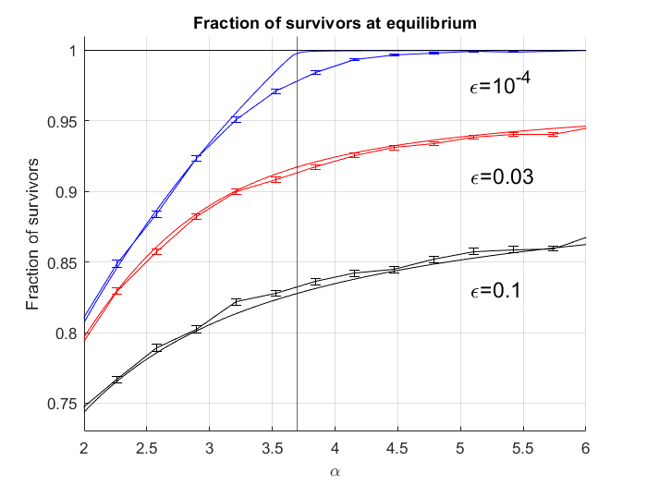
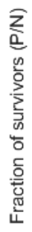
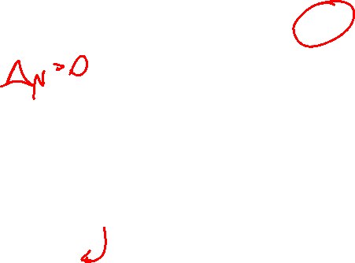


The number of surviving species at equilibrium
$$\#realizations=500$$
$$N=50$$
$$p=0.5$$
$$\overline{δR^{2}}=1$$
$$\overline{R}=1$$
$$ε=[{10}^{−4}, 0.03, 0.1]$$
The number of survival species is given by the number of species with
$$Δ_{μ}=\left(\sum_{i}{\frac{σ_{μi}}{\sum_{i}{σ_{μi}}}⋅h_{i}}\right)−\frac{Χ_{μ}}{\sum_{i}{σ_{μi}}}=0$$
Notes:
Qui la teoria + da cost model e replica trick in SM

Slide 42
The number of surviving species at equilibrium
$$\#realizations=500$$
$$N=50$$
$$p=0.5$$
$$\overline{δR^{2}}=1$$
$$\overline{R}=1$$
$$ε=[{10}^{−4}, 0.03, 0.1]$$
V phase
The number of survival species is given by the number of species with
$$Δ_{μ}=\left(\sum_{i}{\frac{σ_{μi}}{\sum_{i}{σ_{μi}}}⋅h_{i}}\right)−\frac{Χ_{μ}}{\sum_{i}{σ_{μi}}}=0$$
S phase

Slide 43
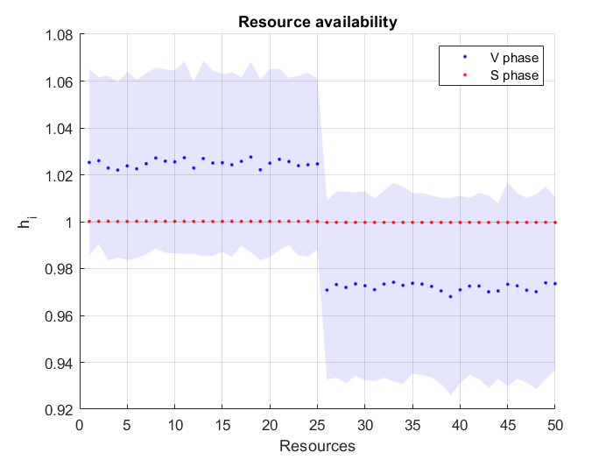


The equilibrium availability of resources
$$\#realizations=500$$
$$N=50$$
$$p=0.5$$
$$\overline{δR^{2}}=1$$
$$\overline{R}=1$$
$$ε={10}^{−3}$$
$$α_{V}=2, α_{S}=10$$
NOTE: $h_{i}=1 ∀i$satisfies the resource balance of all species: neither specialists or generalists have an advantage
Notes:
Qui la teoria + da cost model e replica trick in SM

Slide 44
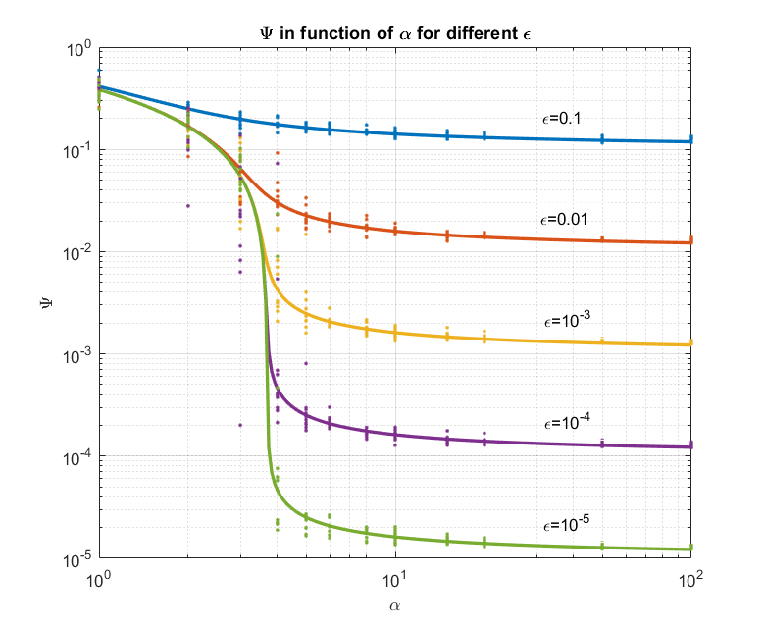


And for finite ε?
$$\#realizations=10$$
$$N=50$$
$$p=0.5$$
$$\overline{δR^{2}}=1$$
$$\overline{R}=1$$
$$ε=[{10}^{−5},{10}^{−4},{10}^{−3},0.01, 0.1]$$
Notes:
Qui la teoria + da cost model e replica trick in SM

Slide 45

Changing the parameters
Modify $\overline{δR^{2} }$

Slide 46
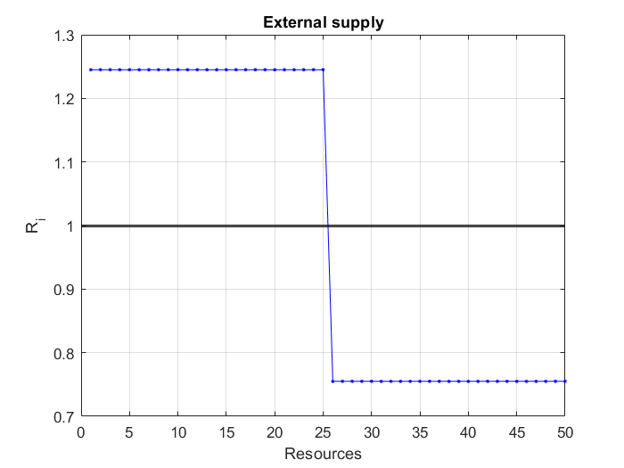


Modify $\overline{δR^{2} }$
$$N=50$$
$$\overline{R}=1$$
$$\overline{δR^{2}}=3$$
$R_{i}= \overline{R}±\frac{δR_{i}}{\sqrt{N}}=1±\frac{\sqrt{3}}{\sqrt{50}}$
Notes:
Qui la teoria + da cost model e replica trick in SM

Slide 47

Modify $\overline{δR^{2}}$
Notes:
Qui la teoria + da cost model e replica trick in SM

Slide 48
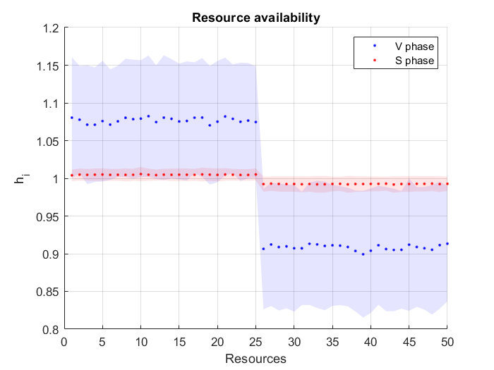
Modify $\overline{δR^{2}}$
Notes:
Qui la teoria + da cost model e replica trick in SM

Slide 49
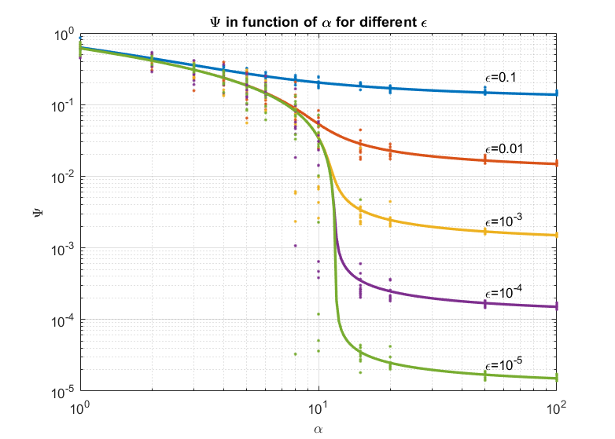
Modify $\overline{δR^{2}}$
Notes:
Transizione di fase per alpha molto più grandi (>10)

Slide 50
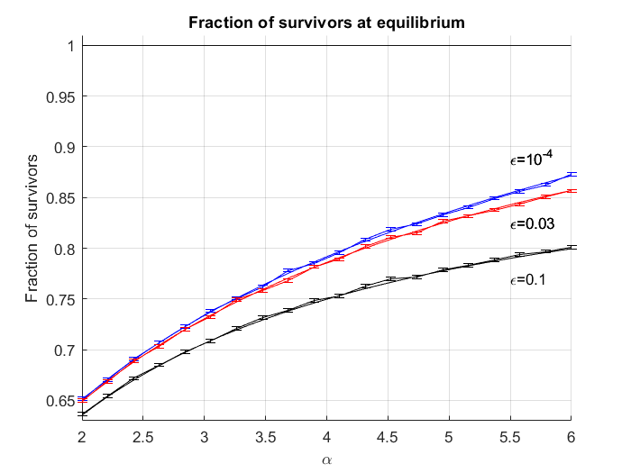
Modify $\overline{δR^{2}}$
Notes:
Per gli stessi alpha non ho PT

Slide 52
Changing the parameters
Modify the external supply

Slide 53
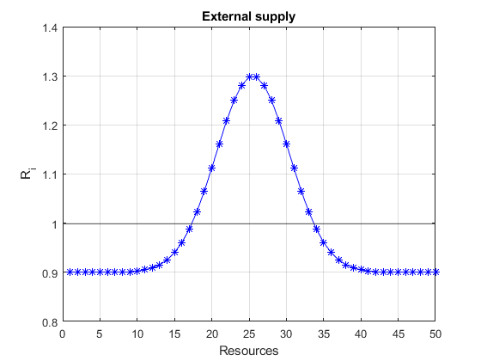
Modify the external supply
Notes:
Qui la teoria + da cost model e replica trick in SM

Slide 54
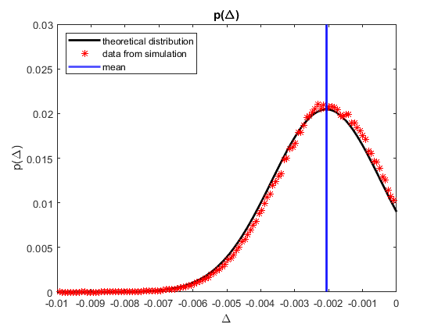
Modify the external supply
Notes:
Qui la teoria + da cost model e replica trick in SM

Slide 55
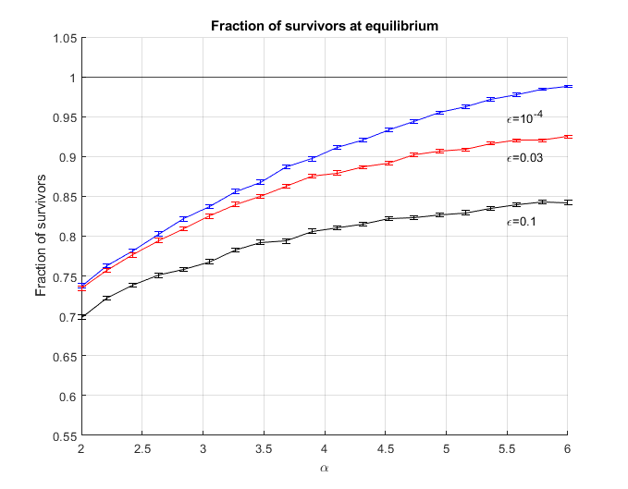
Modify the external supply
Notes:
Qui la teoria + da cost model e replica trick in SM

Slide 56
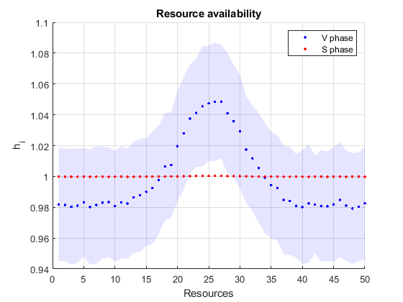
Modify the external supply
Notes:
Qui la teoria + da cost model e replica trick in SM

Slide 57
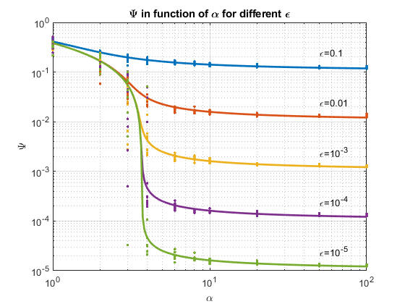
Modify the external supply
Notes:
Qui la teoria + da cost model e replica trick in SM

Slide 58
Changing the parameters
Studying the survival species

Slide 59


Studying the survival species
We observed that $\#survival species≤N$, but it is possible to observe $\#survival species>N$
For all the species $μ=\left\{1,…, P=αN\right\}$
We impose $\sum_{i}^{N}{σ_{μi}=1}$
Notes:
Qui la teoria + da cost model e replica trick in SM

Slide 60

Studying the surviving species
$$N=50$$
$$\overline{R}=1$$
$$\overline{δR^{2}}=1$$
$R_{i}= \overline{R}±\frac{δR_{i}}{\sqrt{N}}=1±\frac{1}{\sqrt{50}}$
We select a fixed cost $Χ_{μ}$ imposing:
$$ε=0$$

Slide 61
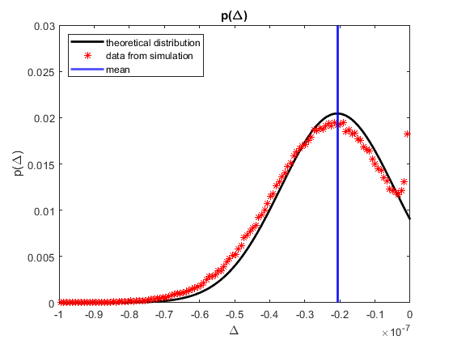
Studying the surviving species

Slide 62
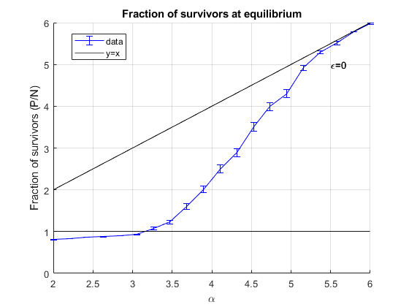
Studying the surviving species

Slide 63
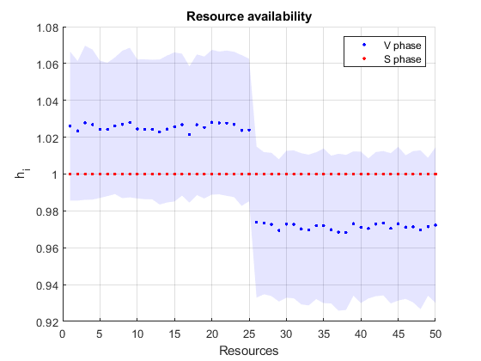
Studying the surviving species

Slide 64
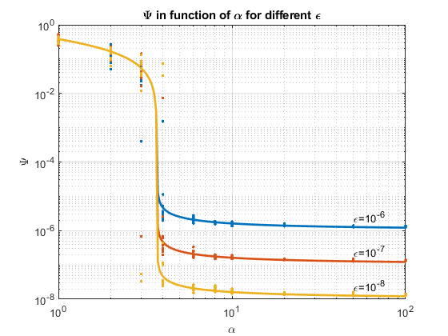
Studying the surviving species

Slide 65
conclusion

Slide 66
Limits & Further studies
No spatial structure → Consider a spatial structure
Inspect just the equilibrium state → out-of-equilibrium statistical physics to study dynamical behavior
Deterministic dynamics
Purely competitive behaviour

Slide 67
Further studies
Consider a different spatial structure
Inspect techniques of out-of-equilibrium statistical physics to study dynamical behavior

Slide 68
conclusions
Tikhonov and Monasson developed methods of statistical physics to analytically solve a classic ecological model of resource competition
In high dimension the systems have a strongly collective regime
The model allows to explore specifically the feedback loop between organisms and their environment
We characterized the environment shaped by a community as consequence of the ecoevolutionary dynamics
Selecting specific survival conditions of the species a number of species greater than the number of supplied resources can survive.

Slide 69
Thank you
Clelia Corridori

Slide 70
Backup slides

Slide 71
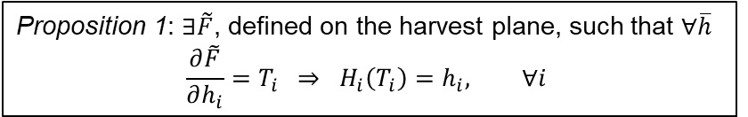
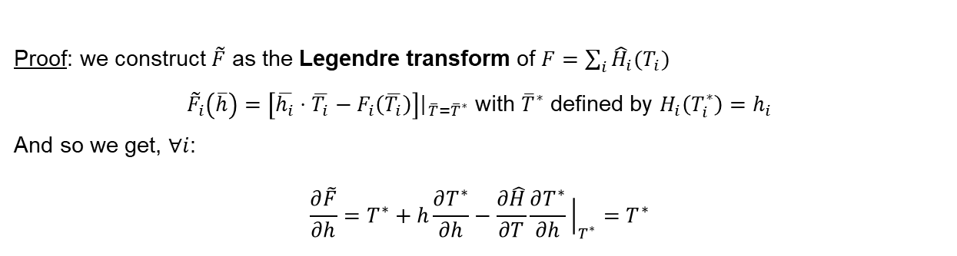
Locating the community equilibrium
Proposition 1: $∃\tilde{F}$, defined on the harvest plane, such that $∀\overline{h}$
$$\frac{∂\tilde{F}}{∂h_{i}}=T_{i} ⇒ H_{i}\left(T_{i}\right)=h_{i}, ∀i$$
Proof: we construct $\tilde{F}$ as the Legendre transform of $F=\sum_{i}{{\hat{H}}_{i}(T_{i})}$
${\tilde{F}}_{i}\left(\overline{h}\right)=\left[\overline{h_{i}}⋅\overline{T_{i}}−F_{i}\left(\overline{T_{i}}\right)\right]{\left.​\right|}_{\overline{T}={\overline{T}}^{∗}}$ with ${\overline{T}}^{∗}$ defined by $H_{i}\left(T_{i}^{∗}\right)=h_{i}$
And so we get, $∀i$:
$$\frac{∂\tilde{F}}{∂h}=T^{∗}+h\frac{∂T^{∗}}{∂h}−\frac{∂\hat{H}}{∂T}\frac{∂T^{∗}}{∂h}{\left.​\right|}_{T^{∗}}=T^{∗}$$

Slide 72
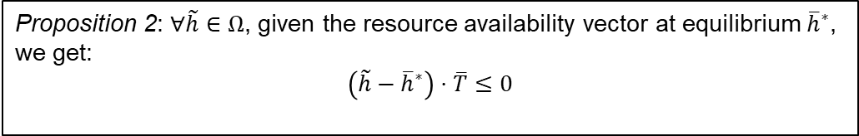
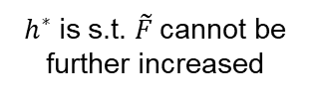
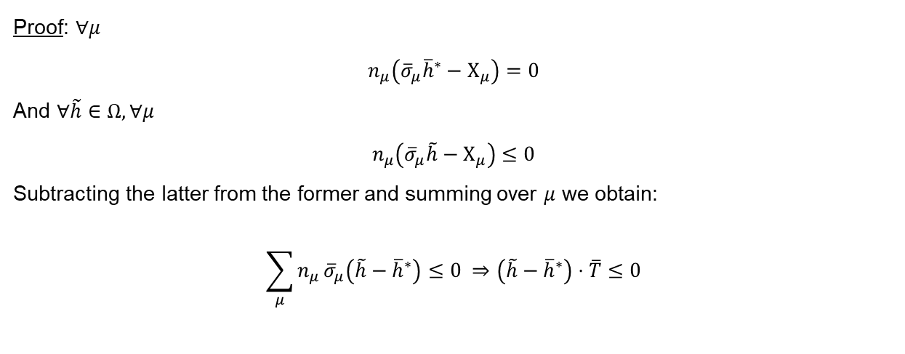
Locating the community equilibrium
Proposition 2: $∀\tilde{h}∈Ω$, given the resource availability vector at equilibrium ${\overline{h}}^{∗}$,
we get:
$$\left(\tilde{h}−{\overline{h}}^{∗}\right)⋅\overline{T}≤0$$
Proof: $∀μ$
$$n_{μ}\left({\overline{σ}}_{μ}{\overline{h}}^{∗}−Χ_{μ}\right)=0$$
And $∀\tilde{h}∈Ω, ∀μ$
$$n_{μ}\left({\overline{σ}}_{μ}\tilde{h}−Χ_{μ}\right)≤0$$
Subtracting the latter from the former and summing over $μ$ we obtain:
$$\sum_{μ}{n_{μ}}{\overline{σ}}_{μ}\left(\tilde{h}−{\overline{h}}^{∗}\right)≤0 ⇒\left(\tilde{h}−{\overline{h}}^{∗}\right)⋅\overline{T}≤0$$
$h^{∗}$is s.t. $\tilde{F}$cannot be further increased

Slide 73
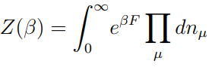
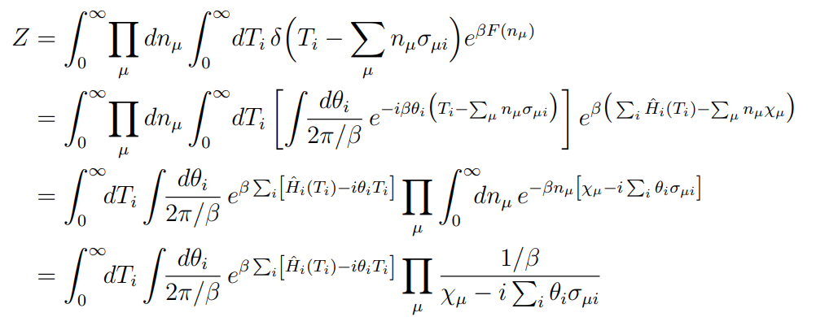
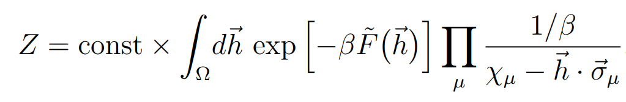
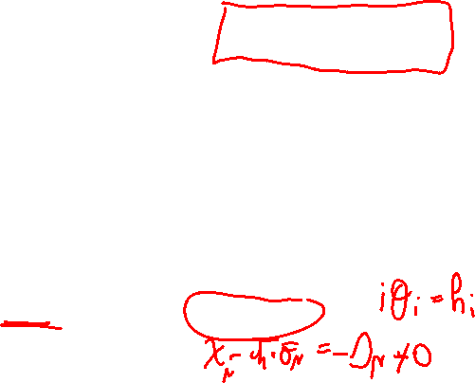
Passing into the harvest space
The partition function in the P-dimensional space is:
We can pass in the N-dimensional space using $T_{i}$ as auxiliary variable:

Slide 74
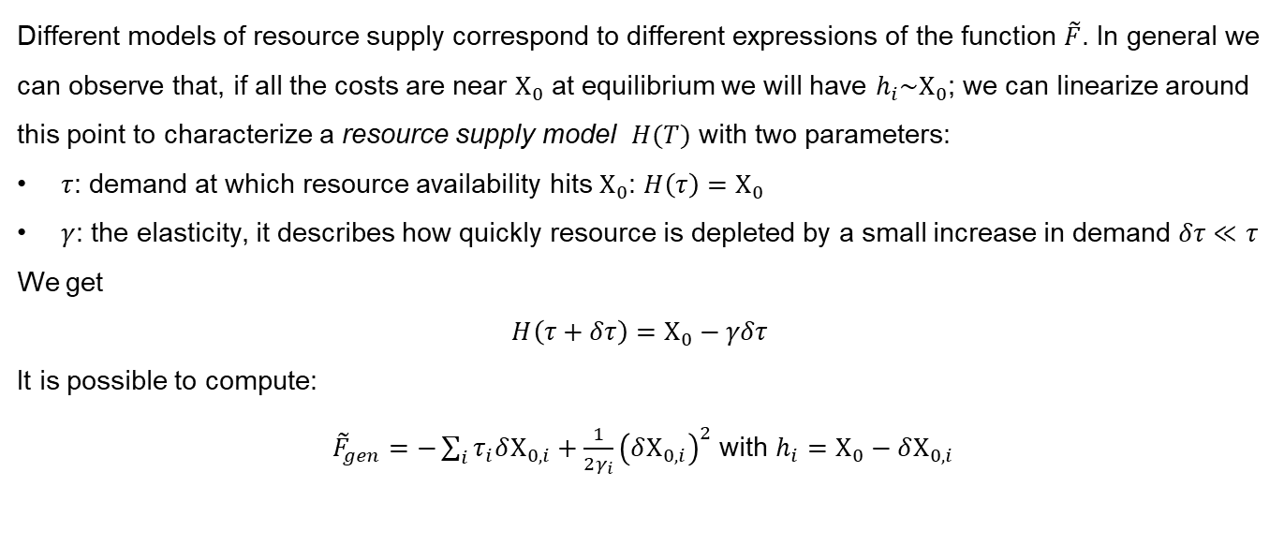
General resource supply model
Different models of resource supply correspond to different expressions of the function $\tilde{F}$. In general we can observe that, if all the costs are near $Χ_{0}$ at equilibrium we will have $h_{i}\sim Χ_{0}$; we can linearize around this point to characterize a resource supply model $H(T)$ with two parameters:
$τ$: demand at which resource availability hits $Χ_{0}$: $H\left(τ\right)=Χ_{0}$
$γ$: the elasticity, it describes how quickly resource is depleted by a small increase in demand $δτ≪τ$
We get
$$H\left(τ+δτ\right)=Χ_{0}−γδτ$$
It is possible to compute:
${\tilde{F}}_{gen}=−\sum_{i}{τ_{i}δΧ_{0,i}+\frac{1}{2γ_{i}}{\left(δΧ_{0,i}\right)}^{2}}$ with $h_{i}=Χ_{0}−δΧ_{0,i}$

Slide 75
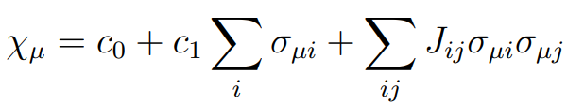
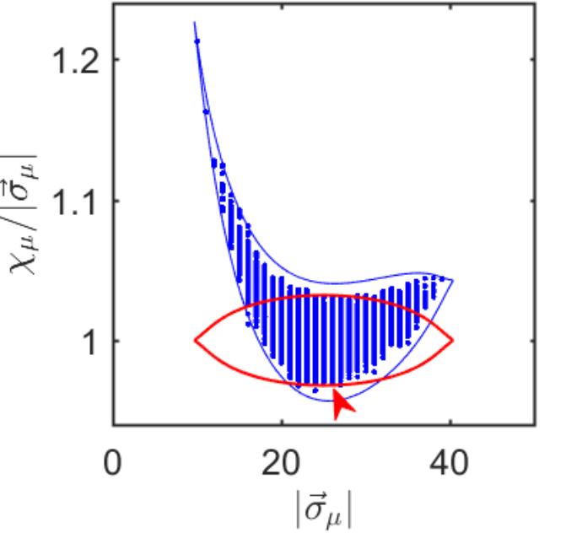

The cost model
Notes:
since competition is restricted to only a subset of species, the self-selected pool of low-cost outliers with similar costs χµ, the details of the cost model matter only inasmuch as they determine the properties of this subset.

Slide 76
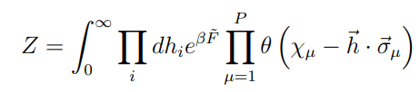
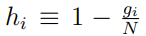
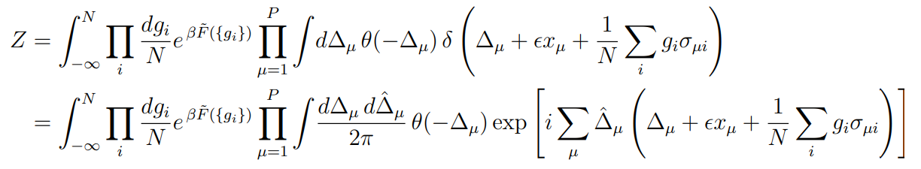
Starting point
with
Notes:
since competition is restricted to only a subset of species, the self-selected pool of low-cost outliers with similar costs χµ, the details of the cost model matter only inasmuch as they determine the properties of this subset.

Slide 77
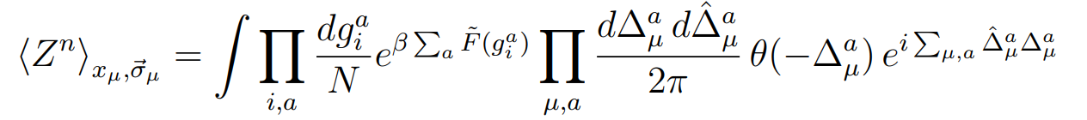
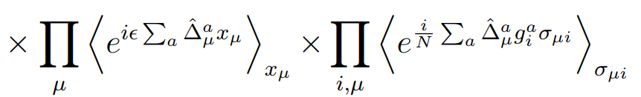

Consider $Z^{n}$
The metabolic strategies and the costs are uncorrelated
Notes:
since competition is restricted to only a subset of species, the self-selected pool of low-cost outliers with similar costs χµ, the details of the cost model matter only inasmuch as they determine the properties of this subset.

Slide 78




Averaging over the disorder
Considering
Notes:
since competition is restricted to only a subset of species, the self-selected pool of low-cost outliers with similar costs χµ, the details of the cost model matter only inasmuch as they determine the properties of this subset.

Slide 79




Decouple indices 𝑖 and 𝜇
Notes:
Inserire qui A e B

Slide 80

Ansatz
Replica symmetry ansatz
The results must be symmetric under a permutation of replicas
Notes:
since competition is restricted to only a subset of species, the self-selected pool of low-cost outliers with similar costs χµ, the details of the cost model matter only inasmuch as they determine the properties of this subset.

Slide 81






Compute the limit $n→0$
Changing variables
with
Notes:
since competition is restricted to only a subset of species, the self-selected pool of low-cost outliers with similar costs χµ, the details of the cost model matter only inasmuch as they determine the properties of this subset.

Slide 82





Final expression
Considering the following equations on $x, λ$ and $q$
Notes:
since competition is restricted to only a subset of species, the self-selected pool of low-cost outliers with similar costs χµ, the details of the cost model matter only inasmuch as they determine the properties of this subset.

Slide 83
Thanks

Slide 84




The Lyapunov function
$F\left(\left\{n_{μ}\right\}\right)=\sum_{i}{{\hat{H}}_{i}\left(T_{i}\right)−\sum_{μ}{n_{μ}Χ_{μ}}}$ with ${\hat{H}}_{i}\left(T_{i}\right)=\int{dT_{i}H_{i}\left(T_{i}\right)}$
Proposition 1: $F$ increases on any trajectory.
Proposition 2: $F$ is bounded from above.
Proposition 3: $F$ is convex.

